Slide 1
RECIPE BOX
KUMARAGURU COLLEGE OF TECHNOLOGY

Slide 2
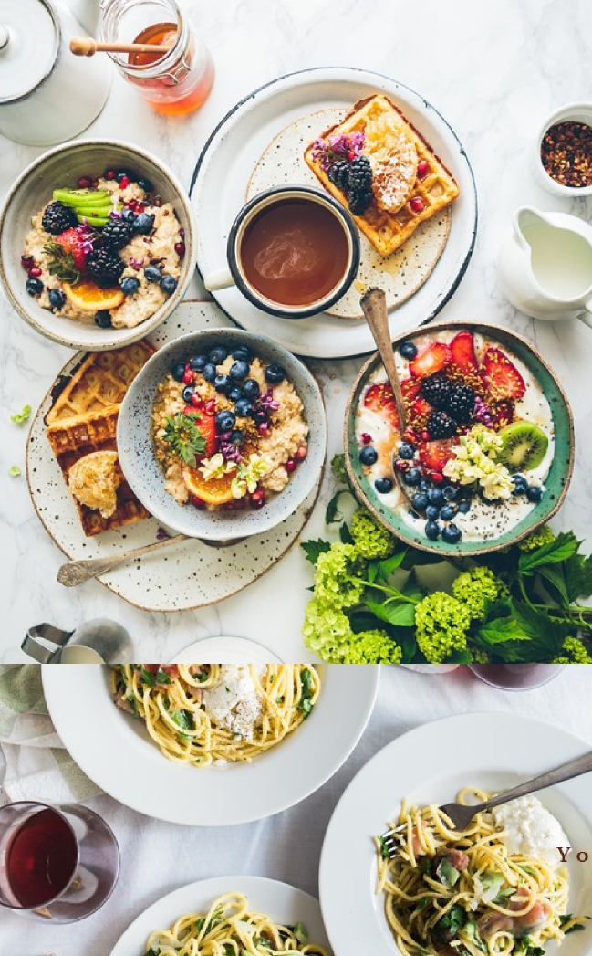
PROBLEM STATEMENT
Cooking enthusiasts and home chefs often struggle to organize and manage their recipes efficiently. Many rely on physical notebooks, screenshots, or disorganized digital notes, making it difficult to find and update recipes when needed. A digital solution is required to store, manage, update, and search for recipes conveniently. Additionally, users should be able to categorize recipes, save favorites, and interact with a community to share cooking ideas.

Slide 3

ABSTRACT
The Recipe Management App is a mobile application developed in Android Studio using Java and SQLite. It enables users to store, retrieve, update, delete, and search recipes efficiently. The app features user authentication, recipe categorization, favorites, and a community module for likes, comments, and following chefs. The recipes include a name, ingredients, cooking steps, an optional image, and a category for easy filtering.
By using SQLite for local data storage, the app works offline without requiring internet access. The app enhances user experience through an intuitive UI, interactive recipe management, and social engagement features. Future enhancements include cloud backup, AI-based recommendations, and multimedia integration

Slide 4
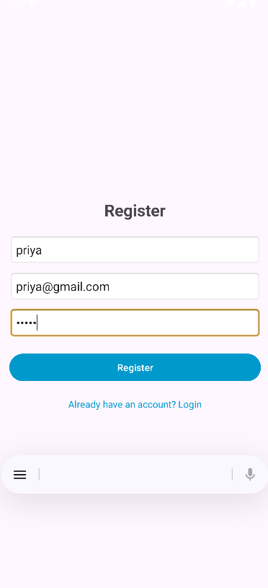
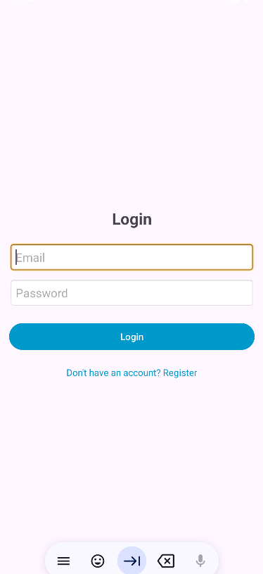

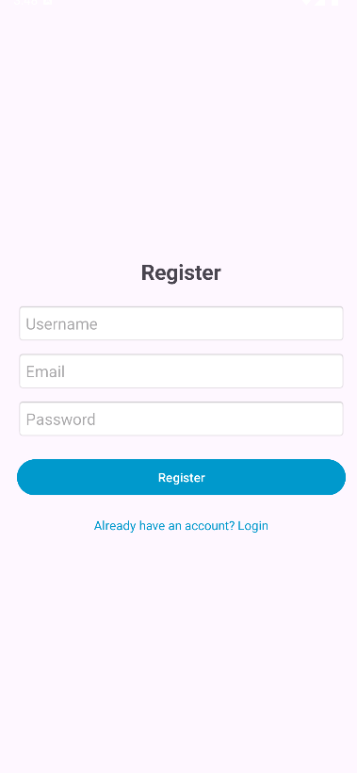
SCREENSHOTS
REGISTER
LOGIN

Slide 5
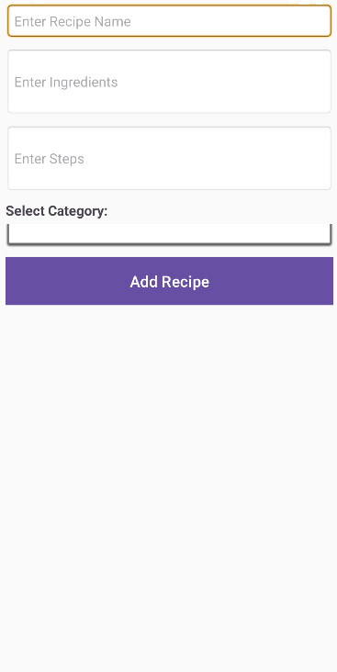
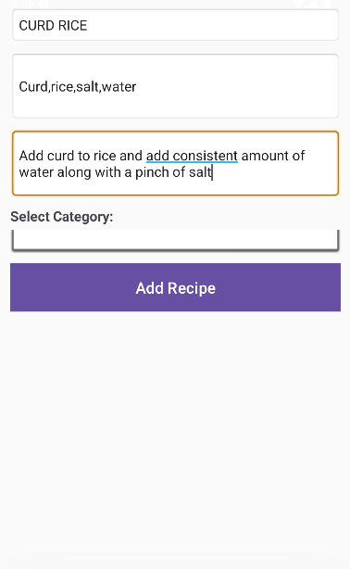
SCREENSHOTS

Slide 6
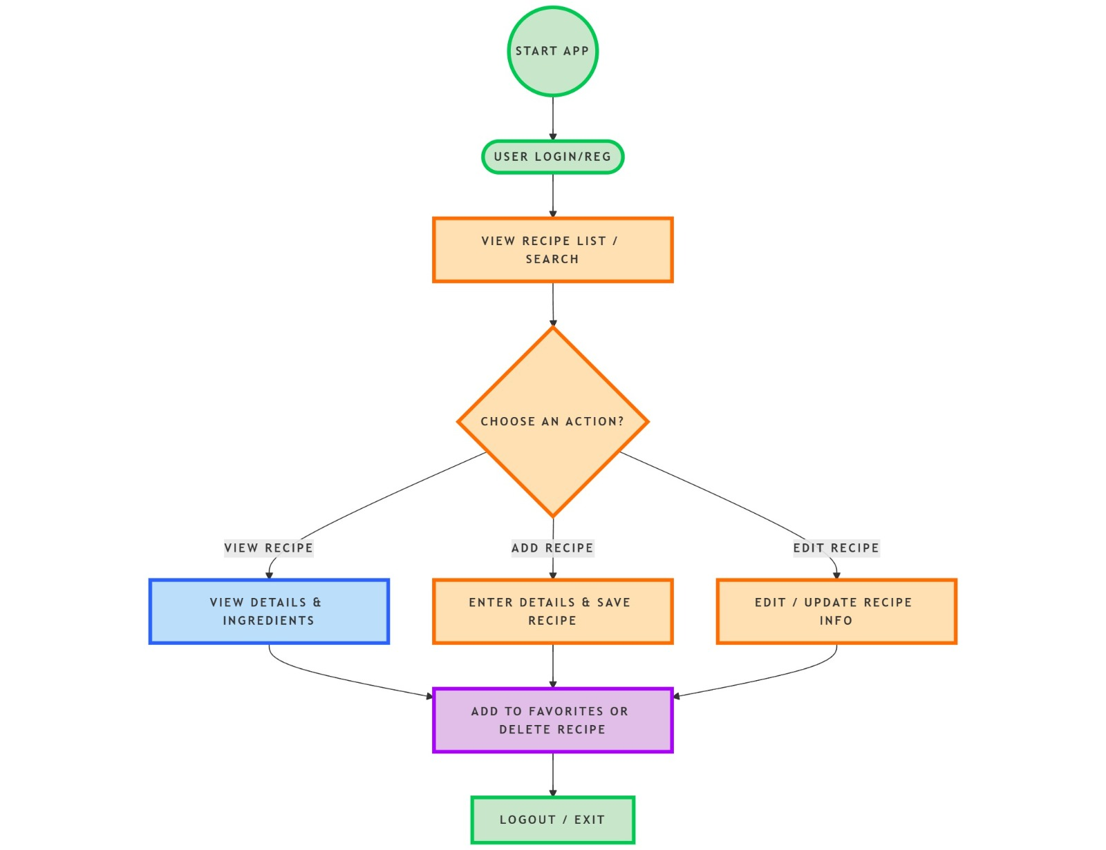
FLOWCHART

Slide 7

ADVANTAGES
Offline Access – No internet required; recipes are stored locally using SQLite. User-Friendly Interface – Easy navigation and recipe management. Quick Search & Filter – Find recipes instantly by name or category. Favorites Feature – Users can save and access their favorite recipes. Community Interaction – Users can like, comment, and follow other chefs. Secure User Authentication – Ensures recipe privacy and personalized experience.

Slide 8

DISADVANTAGES
Limited Storage – SQLite is a local database; large-scale data may slow performance. No Cloud Sync – Recipes are lost if the device is reset or changed. No Video Support – Currently, users cannot upload video tutorials for recipes. Single-Device Limitation – Cannot access saved recipes across multiple devices.

Slide 9

FUTURE SCOPE
Cloud Integration – Use Firebase or Google Drive for online backup and multi-device sync. AI-Based Recommendations – Suggest recipes based on user preferences. Voice Commands – Allow users to add and search for recipes using voice input. Step-by-Step Guided Cooking Mode – Display cooking steps with timers. Ingredient Shopping List – Generate a shopping list from selected recipes. Video & Image Uploads – Users can share video tutorials along with text recipes.

Slide 10
Thank you!

